Slide 1
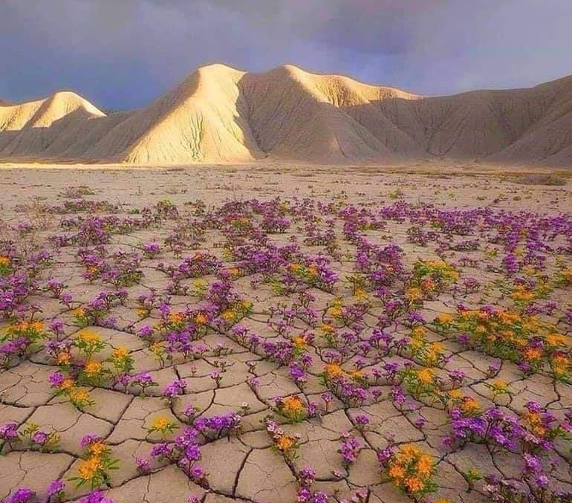
God is working
Pastor Guine Anderson
Harvest NOW Inc.

Slide 2
God is working
Habakkuk complains to God about the injustices surrounding him
The teachings are weak, and justice never comes. Evil people gain while good people lose; the judges no longer make fair decisions. (Habakkuk 1:4)
?

Slide 3
God is working
The LORD says,
A
“I will do something in your lifetime that you won't believe even when you are told about it.”
(Habakkuk 1:5)

Slide 4
God is working
Then the Lord replied:
“Write down the vision / revelation
and make it plain on tablets
so that a herald may run with it.”
(Habakkuk 2:2)
A

Slide 5
God is working
The Lord replied:
A
“But those who are righteous (Just) with God will live by trusting in him.”
(Habakkuk 2:4)
The Just shall live by Faith.

Slide 6
God is working
Then, just as water covers the sea, people everywhere will know the LORD's glory.”
(Habakkuk 2:12-14)

Slide 7
God is working
Habakkuk prays, “LORD, I have heard the news about you; I am amazed at what you have done. Lord, do great things once again in our time…
But I will wait patiently for the day of disaster that will come to the people who attack us.” (Habakkuk 3:2 & 16)

Slide 8
God is working
"There may be no olives growing and no food growing in the fields. There may be no sheep in the pens and no cattle in the barns. But I will still be glad in the LORD; I will rejoice in God my Savior." (Habakkuk 3:17-18)

